Slide 1
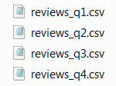










ETL USING LUIGI
Reviews
- Temp_reviews
- Reviews
xls
- Temp_xls
- xls
json
- Temp_json
- json
create_reviews_db.py
etl_pipeline_reviews.py
disaster
- Temp_disaster
- disaster
output-YYYY-MM-DD HHMMSS.csv

